Slide 1

Date:15th May 2021
CVR COLLEGE OF ENGINEERING DEPARTMENT OF COMPUTER SCIENCE AND ENGINEERING
A Project seminar-I
on
EarthQuake Prediction Model
Using Machine Learning
Under guidance of
Mrs. V. N. V. L. S. Swathi , Asst. Professor
by
17B81A0585 : K. Kalyan
17B81A0587 : G. Karthik Sai Teja
17B81A0590 : C. Keerthan Reddy

Slide 2
Contents
Introduction
Abstract
Motivation
Literature Survey
Limitations of the existing models
Proposed model
Requirements
Architecture of the Model
Use case diagram
Class diagram
Sequence diagram
Results
Future scope
Conclusion
References

Slide 3
Introduction
An earthquake is a calamitous occurrence that is detrimental to human interest and has an undesirable impact on the environment. Earthquakes have always caused incalculable damage to structures and properties and caused the deaths of millions of people throughout the world. In order to minimize the impact of such an event, several national, international and transnational organizations take various disaster detection and prevention measures. Time and quantity of the organization’s resources are limiting factors, and organization managers face several difficulties when it comes to the distibution of the resources.

Slide 4
Abstract
Abstract
The damage that is caused by an earthquake was classified into damage grades, ranging in values from one to five. A data set is used, wherein a series of parameters were taken into consideration to predict the damage grade of a given building, which is associated with a Unique Identification String. The prediction was done using a survey of existing machine learning classifier algorithms. The machine learning algorithms used in this work were Naive Bayes Classifier, Decision Tree, Neural Network model. Based on an evaluation of a set of attributes, the most appropriate algorithm was considered. A detailed analysis was done on the predicted attribute by the given algorithm, followed by data analysis that provided details that could help mitigate the impact of an earthquake in future.

Slide 5
Literature Survey
Literature Survey
Major earthquake event prediction using various machine learning algorithms :
https://ieeexplore.ieee.org/document/9032983
Authors: Roxane Mallouhy, Chady Abou Jaoude,Christophe Guyeux ,Abdallah Makhoul.
This Paper aims to predict short term earthquake prediction using various Machine Learning algorithms.
Earthquake prediction: probabilistic aspect:
https://ieeexplore.ieee.org/document/8143018
Authors: G. Molchan and V. Keilis-Borok.
This Paper aims to predict earthquake using probabilstic approach.

Slide 6
Limitations of
Existing Model
The prediction was only about occurance of earthquake but not the impact of the earthquake.
There are less model which predict the magnitude of earthquake.
Even though magnitude is predicted each individual building damage must be predicted for evacuation.

Slide 7
Proposed System
Leveraging the power of machine learning is a viable option to predict the degree of damage that is done to buildings from earthquake.
It can help identify safe and unsafe buildings which helps to predict damage prone areas and thus avoiding death and injuries resulting from the aftershock of an earthquake, while simultaneously making rescue efforts efficient.
Thus predicting the damage grade of building helps us in evacuation process.

Slide 8
Software Requirements
Operating System(s) : Windows 7, 8, 10
Programming Language : Python
Framework: Jupyter Notebook
Machine Learning Algorithms

Slide 9
Hardware Requirements
i3 Processor Based Computer or higher
Memory: 1 GB or
higher
Hard Drive: 50 GB

Slide 10
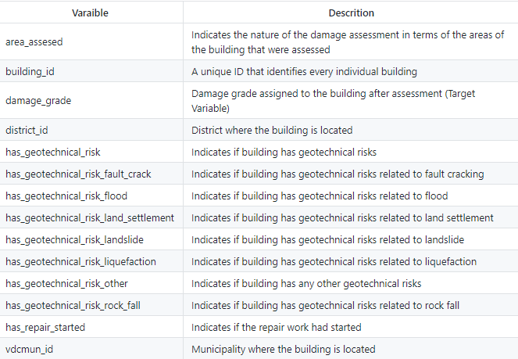
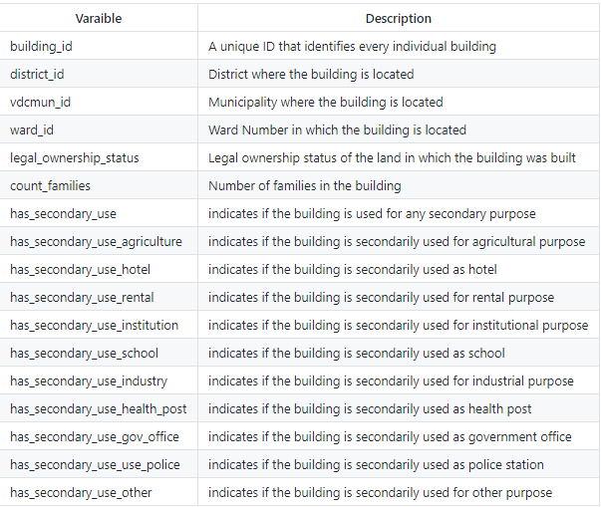
DataSet Requirement
Data set is taken from : https://www.kaggle.com/arpitr07/predict-building-damage-grade/output
Table-1 training data
Table-2 building ownership data

Slide 11
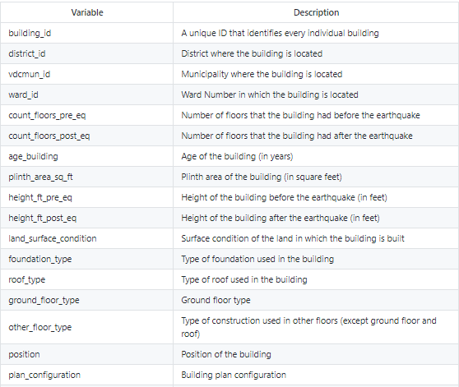
DataSet Requirement
Table-3 building structure data

Slide 12
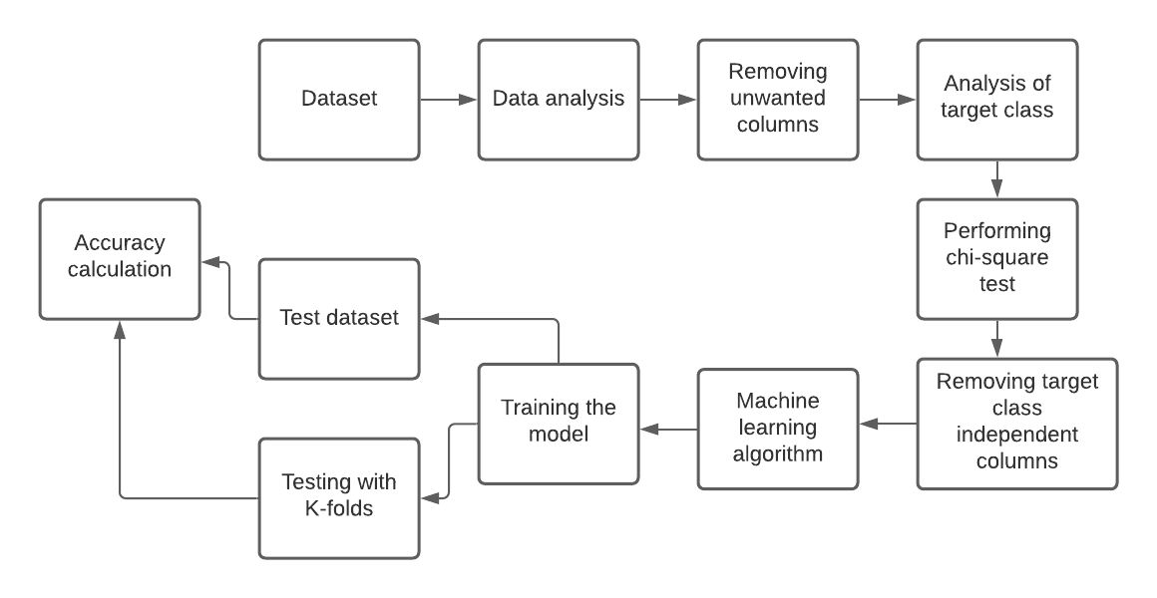
Architecture Diagram
Fig.1
Architecture Diagram

Slide 13
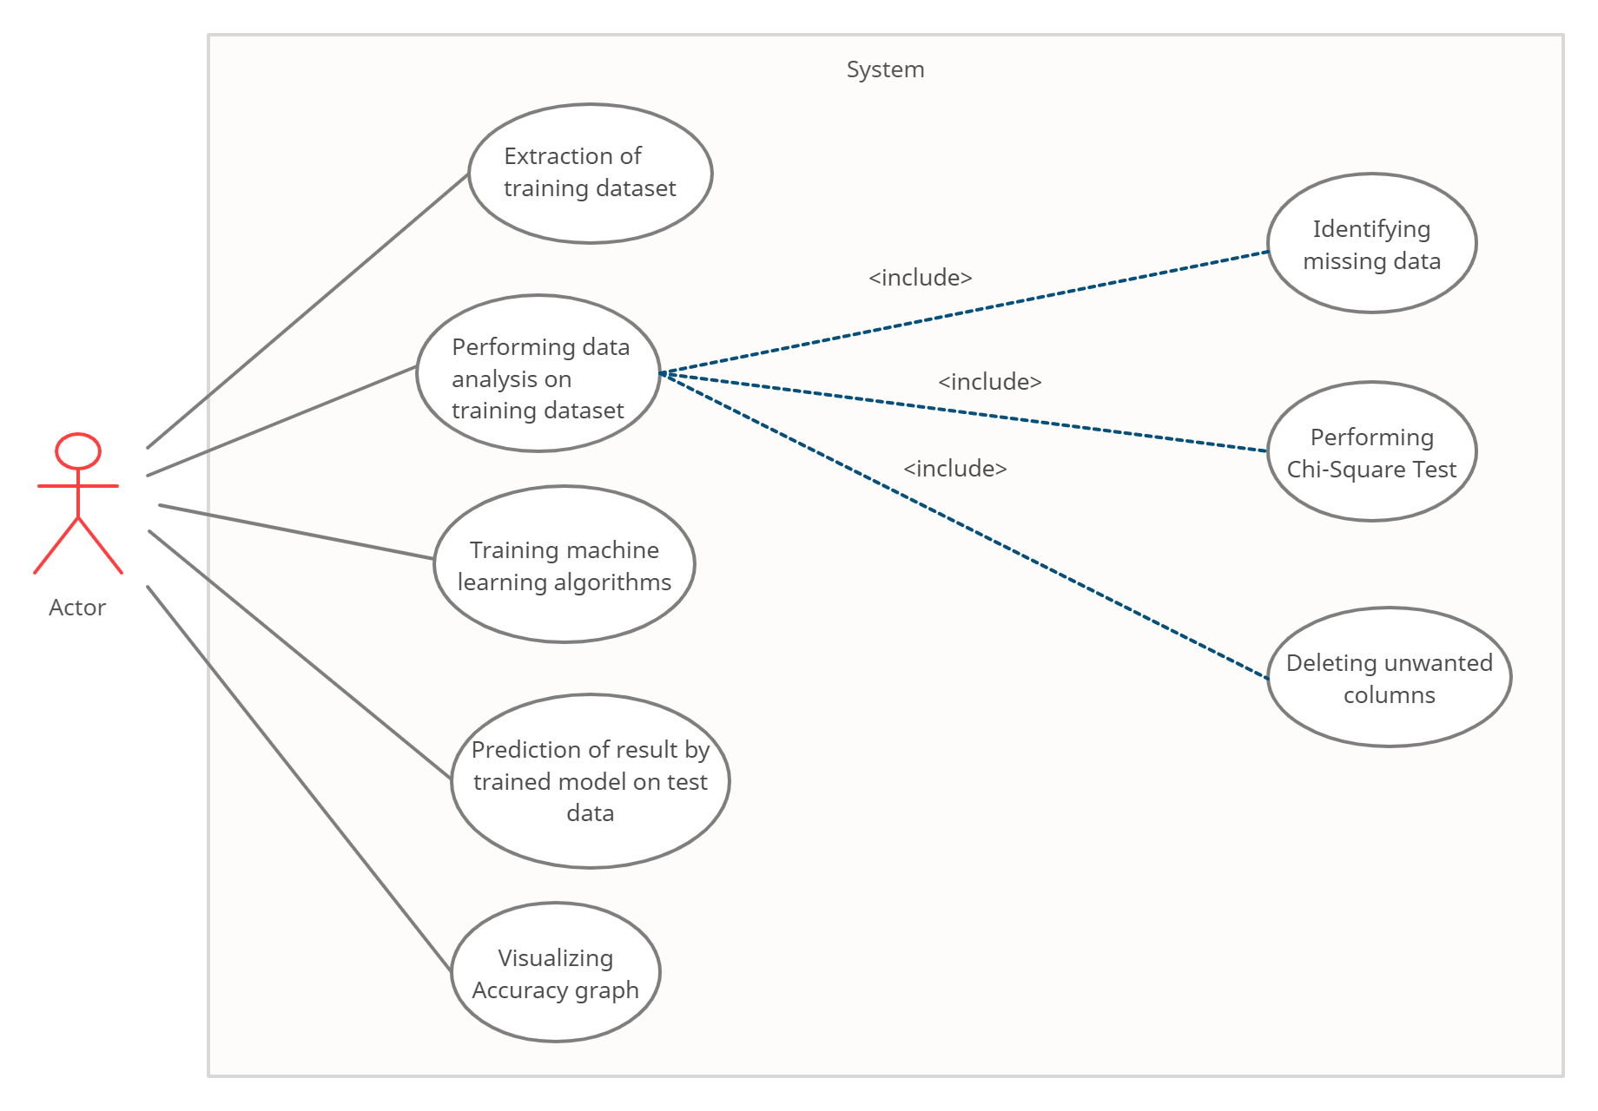
Use Case Diagram
Fig.2
Use Case Diagram

Slide 14
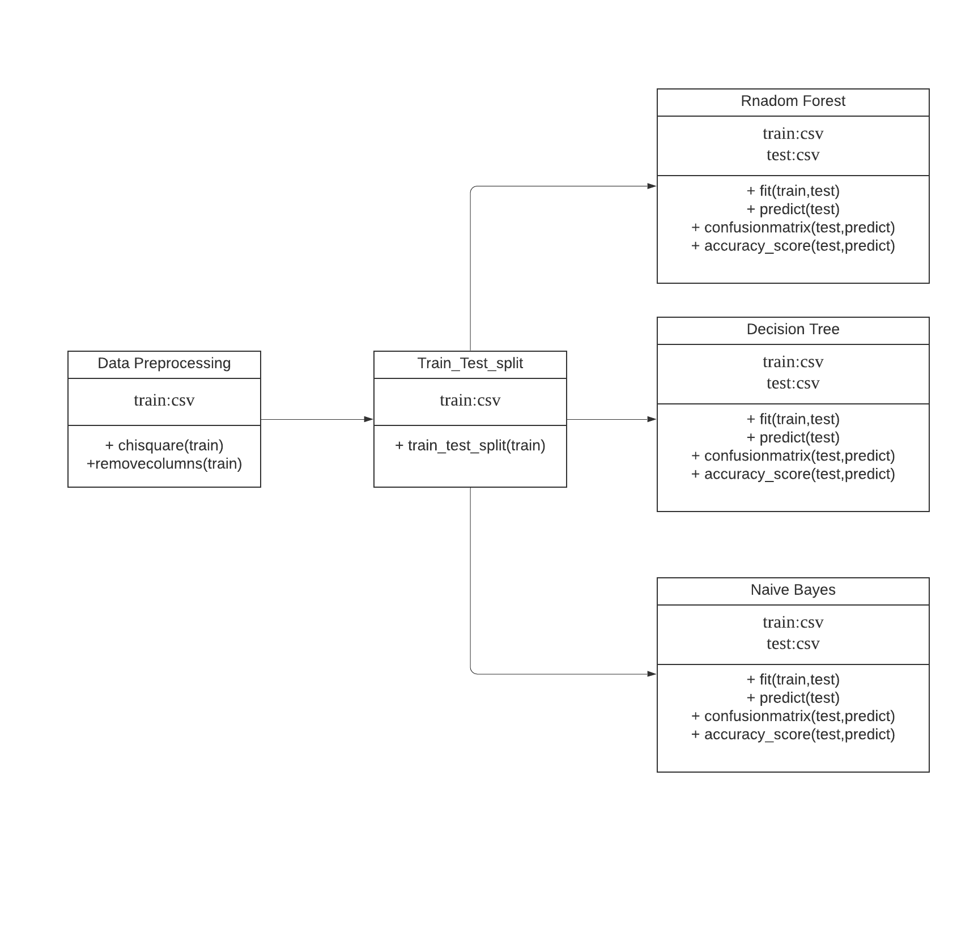
Class Diagram
Fig.3
Class diagram

Slide 15
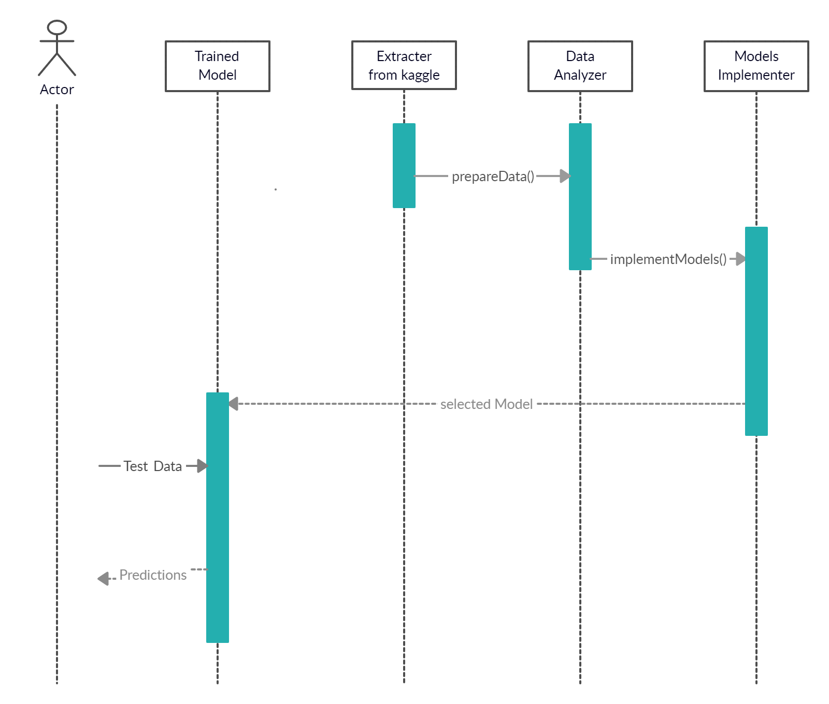
Sequence Diagram
Fig.4
Sequence Diagram

Slide 16
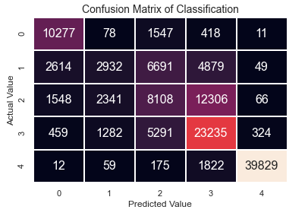
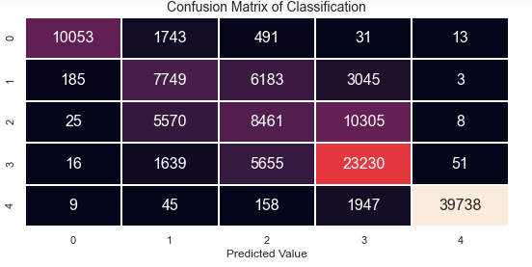
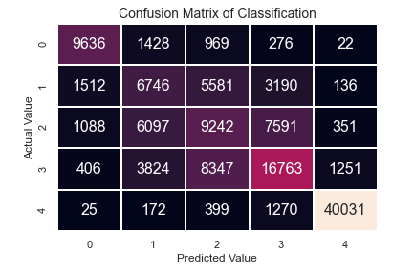
Results
Fig.5
Confusion matrix of Naive Bayes’
Fig.6
Confusion matrix of Neural Networks
Fig.7
Confusion matrix of Decision Tree

Slide 17
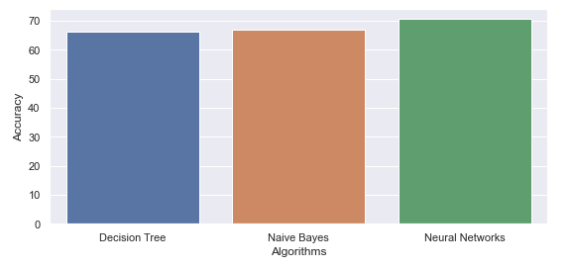
Results
Algorithm | Accuracy
Decision Tree | 66.19
Naive Bayes | 68.55
Neural Networks | 70.59
Fig.8
Accuracy Graph
Table-1
Accuracy Comparision

Slide 18
Future Scope
There are some of the aspects of the project which can be improved in future such as:
A dataset with more variation and a higher quality can really boost the accuracy of our current models. Also we think that using more complex models like artificial neural networks, or applying deep learning.
Maintaing a realtime data of building structure would help in better prediction.
Using hybrid models for increasing accuracy.

Slide 19
Conclusion
Thus, the aim of this project is to predict the damage grade of buildings. The Neural Network is high accurate in predicting compared to Naive bayes and Decision Tree.
It is also seen that damage grade 1,5 have high accuracy in prediction.

Slide 20
References
Roxane Mallouhy, Chady Abou Jaoude,Christophe Guyeux ,Abdallah Makhoul, “Major earthquake event prediction using various machine learning algorithms.” https://ieeexplore.ieee.org/document/9032983
G. Molchan and V. Keilis-Borok, “Earthquake prediction: probabilistic aspect.” https://ieeexplore.ieee.org/document/8143018
Adqas Ikram and Usman Qamar, “Seismic Data Analysis for Earthquake Prediction: A Machine Learning Approach.” https://huckg.is/gisruk2017/GISRUK_2017_paper_12.pdf
https://scikit-learn.org/stable/supervised_learning.html#supervised-learning

Slide 21


